Slide 1

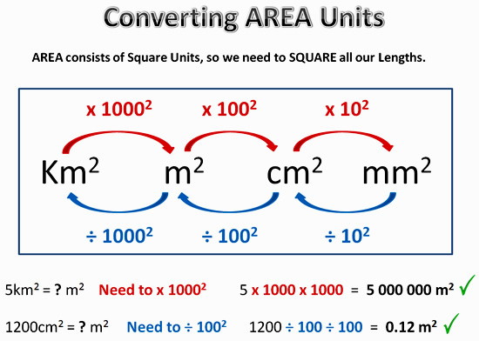
My Measurement Interactive Notebook
Name
Class
Teacher Mr Evans
Term 1 Semester 1
1

Slide 2
Contents
Glossary or Formula Page
Page
Date
Description
2
3

Slide 3
Tasks
24
7
30
Essential Question
Questions
Notes
Summary
6
7

Slide 4
Area demo
Parallelogram demo

Slide 5
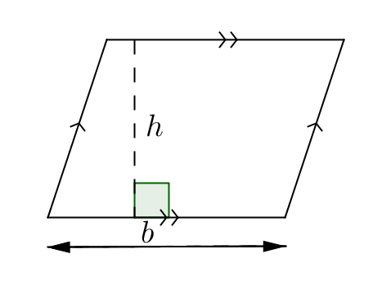
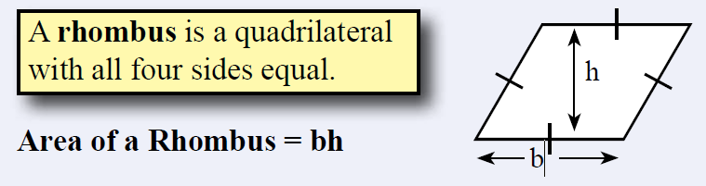
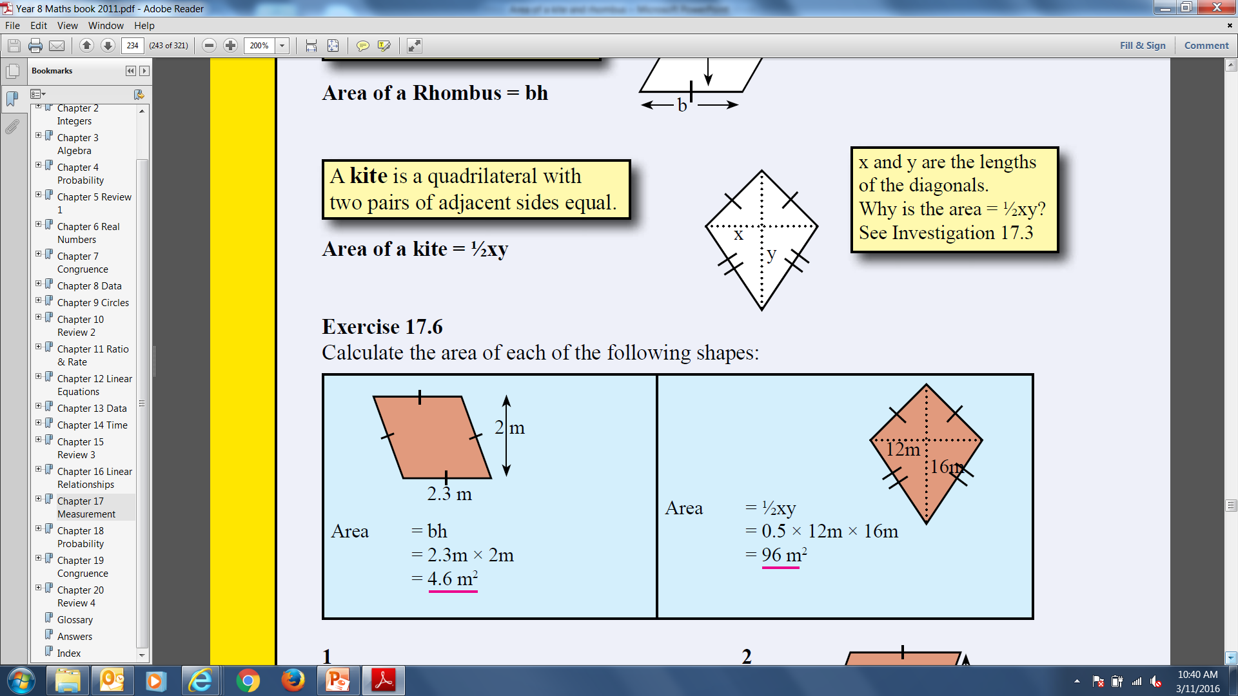


24
7
30
Date
Area of parallelograms and rhombi
EQ – Describe how to calculate the areas of different quadrilaterals.
$$Area=base ×height$$
$$A=bh$$
Rhombus:
Example:
5

Slide 6
Examples
3
4

Slide 9
Notes Review
24, 7 ,30
Date
Title
Essential question
Notes complete
Notes complete with colour and diagrams
Questions completed
Contents page filled in
Formula page filled in

Slide 10
Homework
Review your notes and write a summary answering the essential question.

